Slide 2
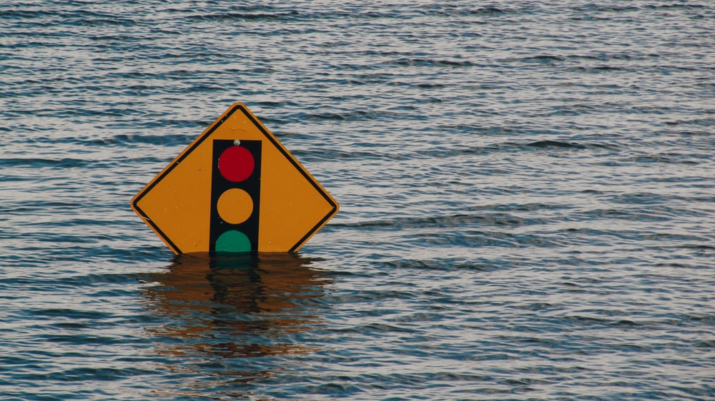
"Stop that!" What does compliance mean for development?
Notes:
Image: https://images.unsplash.com/photo-1485617359743-4dc5d2e53c89?ixlib=rb-1.2.1&ixid=eyJhcHBfaWQiOjEyMDd9&auto=format&fit=crop&w=1267&q=80

Slide 3




Chris Unwin
Solutions Architect – Redgate
Blogger – PlantBasedSQL.com
@PlantBasedSQL
DBAle Presenter
Lover of data masking
“Oh hey look it’s that data masking guy” - PASS Summit 2019

Slide 4
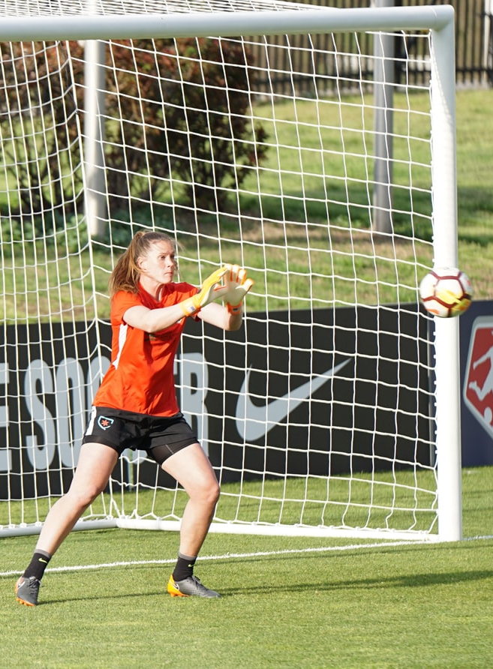
Goal
“To understand some key common aspects of global data protection laws and to describe 10 steps that can help us build our own defensible position.”

Slide 5



Hold up, defensible position?
ISO 27001
Cyber Essentials
EuroPriSe
Notes:
Images:
https://images.unsplash.com/photo-1484480974693-6ca0a78fb36b?ixlib=rb-1.2.1&ixid=eyJhcHBfaWQiOjEyMDd9&auto=format&fit=crop&w=1352&q=80
https://images.unsplash.com/photo-1443890923422-7819ed4101c0?ixlib=rb-1.2.1&ixid=eyJhcHBfaWQiOjEyMDd9&auto=format&fit=crop&w=1350&q=80

Slide 6


It all comes down to sensitive data
You’re fat.
ID | Name
1 | Joe
2 | Kiesha
3 | Skye
I’m not fat I’m BIG data.
No, fortunately I don’t mean this.

Slide 7








Of course we all know what sensitive data means… do we?
PII: Personally Identifiable Information
PHI: Protected Health Information
PCI: Payment Card Information

Slide 8



Why are we protecting data in the first place?
Unfortunately, Data Breaches are an all too common occurrence…
500m Records
360m Records
148m Records
There needs to be something that protects the rights of those people…

Slide 9
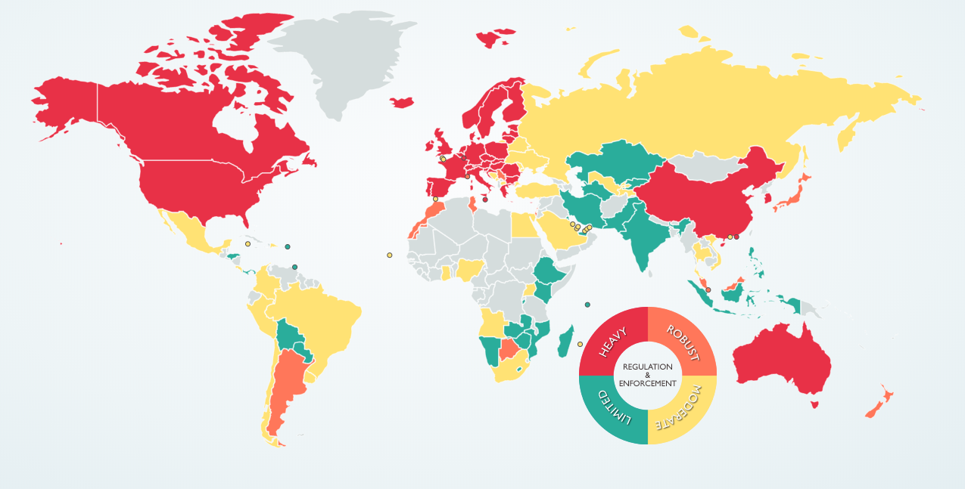

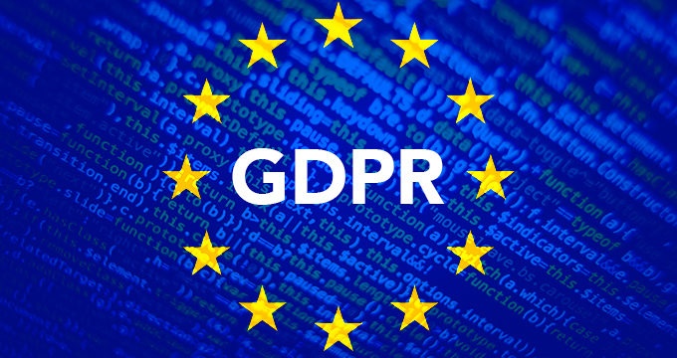


There’s quite a few regulations now to help with that…
Source: DLA Piper - DATA PROTECTION LAWS OF THE WORLD
Notes:
Link: https://www.dlapiperdataprotection.com/

Slide 10
What do privacy laws all care about?
You.
Well… Data Subjects.

Slide 11
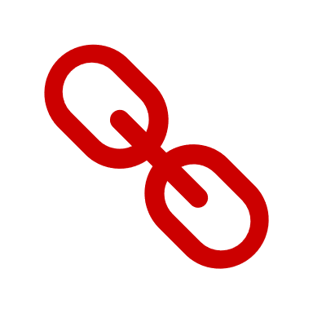



Quick definition
Data Subjects
Data Controllers
Data Processors

Slide 12





There’s GDPR
Date Introduced:
25th May 2018
Location Introduced:
European Union & EEA
Relates to what data:
Any personal data of EU citizens (PII/PHI)
Maximum fine:
€20 million ($23.6 million)
or 4% of Annual Global Turnover
Notes:
Link: https://www.dlapiperdataprotection.com/

Slide 13

There’s POPIA
Date Introduced:
1st July 2020 (with 1 year ‘grace’ period)
Location Introduced:
South Africa
Relates to what data:
Any personal data of South African citizens / residents (PII/PHI)
Maximum fine:
R10 million ($590,000)
and/or 12 months imprisonment
Notes:
Link: https://www.dlapiperdataprotection.com/

Slide 14

There’s CaCPA
Date Introduced:
28th June 2018 (eff. 1st January 2020)
Location Introduced:
California (USA)
Relates to what data:
Any personal data of Californian residents (PII/PHI)
Maximum fine:
$7,500 per violation for
intentional violation, uncapped maximum
Notes:
Link: https://www.dlapiperdataprotection.com/

Slide 15








There’s… well, a whole bunch more.
Notes:
Link: https://www.dlapiperdataprotection.com/

Slide 16

But what do they all have in common?
Notes:
Image: https://images.unsplash.com/photo-1583527234240-b1c4f7c8f865?ixlib=rb-1.2.1&ixid=eyJhcHBfaWQiOjEyMDd9&auto=format&fit=crop&w=675&q=80

Slide 17
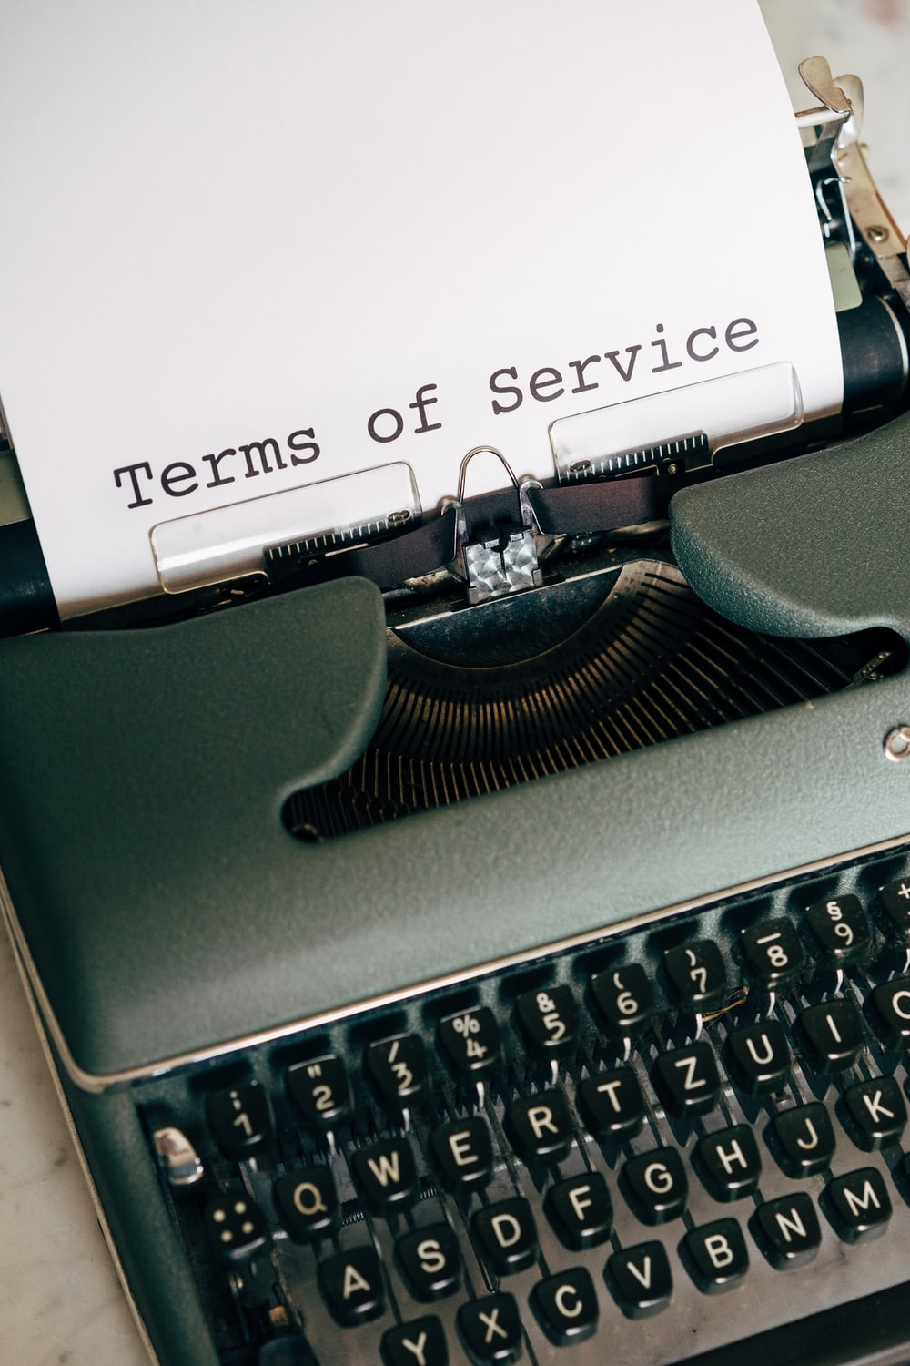
Common Principle #1: Purpose Limitation
Collect data only for a specific purpose and be explicit about what and why you are collecting it.
GDPR Art. 5 - 1(b)
POPIA Chapter 3 (A) C3 S13
CCPA 1798.100.(b)
Notes:
Image: https://images.unsplash.com/photo-1585995604064-e1c454b311d0?ixlib=rb-1.2.1&ixid=eyJhcHBfaWQiOjEyMDd9&auto=format&fit=crop&w=634&q=80

Slide 18
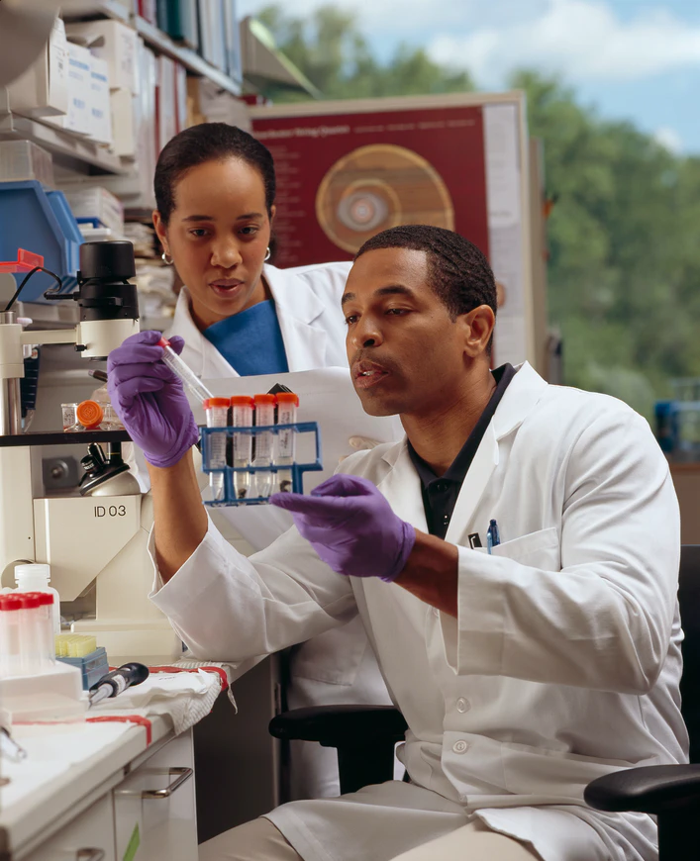
Common Principle #2: Process Minimization
Limit the processing of data to the absolute minimum to achieve a given purpose.
GDPR Art. 5 - 1(e)
DIFC Law No. 5 Part 2A 9(1) (c)
LGPD Art. 6 III
Notes:
Image: https://images.unsplash.com/photo-1582719471137-c3967ffb1c42?ixlib=rb-1.2.1&ixid=eyJhcHBfaWQiOjEyMDd9&auto=format&fit=crop&w=707&q=80

Slide 19
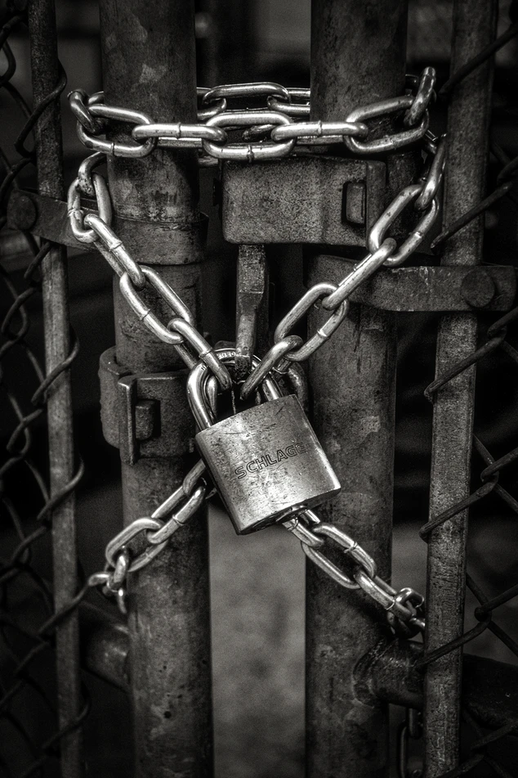
Common Principle #3: Confidentiality & Integrity
Ensure complete security of the data during processing activities and minimize risk of unauthorized access.
HIPAA SEC. 1173. (a)(3)(d)(2)(a)
POPIA Chapter 3 (A) C7 S19
DIFC Law No. 5 Part 2A 9(1) (i)
Notes:
Image: https://images.unsplash.com/photo-1508345228704-935cc84bf5e2?ixlib=rb-1.2.1&ixid=eyJhcHBfaWQiOjEyMDd9&auto=format&fit=crop&w=634&q=80

Slide 20

Common Principle #4: Accuracy
Keep data up to date and relevant, any old/outdated data should be rectified or deleted as soon as possible.
GDPR Art. 5 - 1(d)
POPIA Chapter 3 (A) C5 S16
LGPD Art. 6 V
Notes:
Image: https://images.unsplash.com/photo-1510925751334-0fe90906839b?ixlib=rb-1.2.1&ixid=eyJhcHBfaWQiOjEyMDd9&auto=format&fit=crop&w=639&q=80

Slide 21

Bonus Common Principle #5: Accountability
Prove it.
GDPR Art. 5 - 2
POPIA Chapter 3 (A) C1 S8
LGPD Art. 6 X
DIFC Law No. 5 Part 2A 9(2)
HIPAA SEC. 1175. (a) (2)
PIPEDA Fair Information Principle 1
Notes:
Image: https://images.unsplash.com/photo-1494809610410-160faaed4de0?ixlib=rb-1.2.1&ixid=eyJhcHBfaWQiOjEyMDd9&auto=format&fit=crop&w=634&q=80

Slide 22
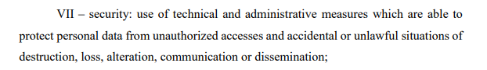
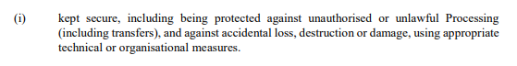
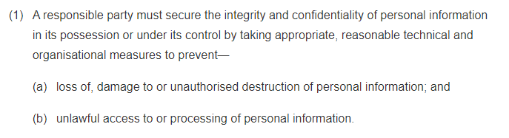
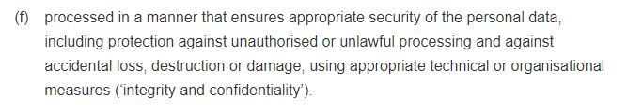
So what do we have to do?

Slide 23




The big question: What DOES compliance mean for development?
Technical and organizational measures.
Process.

Slide 24

“DevOps is the union of people, processes and products to enable continuous delivery of value to our end users.”
Donovan Brown Principal DevOps Manager at Microsoft
Notes:
Image: http://developeronfire.com/assets/images/DonovanBrown.jpg

Slide 25
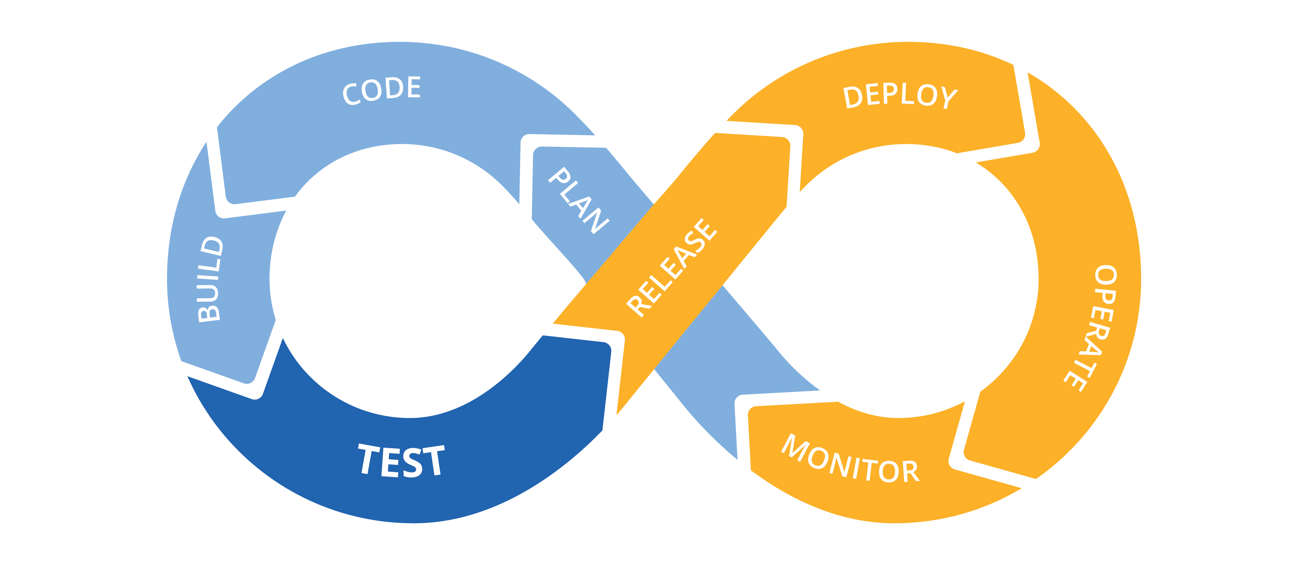
We all know what DevOps is…
Notes:
Image: http://blog.xebialabs.com/wp-content/uploads/2016/03/DevOps-cycle-PPT-COLOURS.png

Slide 26
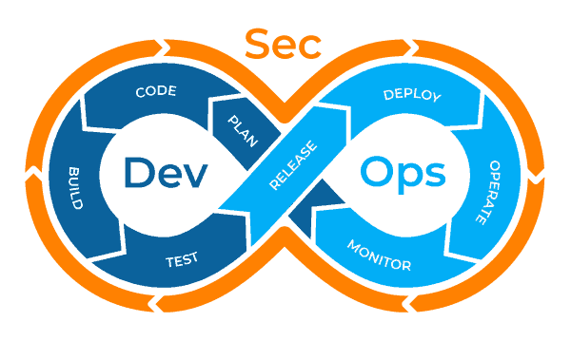
So let’s build security in from the beginning!
Notes:
Image: https://www.plutora.com/wp-content/uploads/2019/03/DevSecOps-Diagram.png

Slide 27

10 tips to build your defensible position

Slide 28

Defensible Position Tip #1
Identify where your data is
Gather an inventory of everywhere that data exists that might be used by developers
Old backups stored on network drives are prime real-estate
Old forgotten / disused instances and servers wherever they exist
Notes:
Image: https://images.unsplash.com/photo-1553413077-190dd305871c?ixlib=rb-1.2.1&ixid=eyJhcHBfaWQiOjEyMDd9&auto=format&fit=crop&w=675&q=80

Slide 29
Defensible Position Tips #2 & #3
Identify what your data is and what is at risk
You can’t protect what you don’t know you have
Create a new way of discussing the data you hold across the organisation
Understand what is at stake each time you make a decision about data
Notes:
Image: https://images.unsplash.com/photo-1582547766135-5940c6d3b50d?ixlib=rb-1.2.1&ixid=eyJhcHBfaWQiOjEyMDd9&auto=format&fit=crop&w=634&q=80

Slide 30
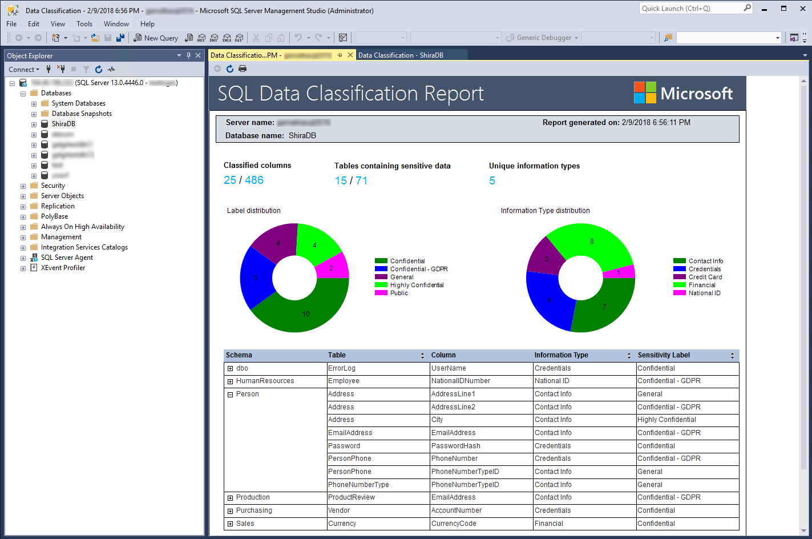
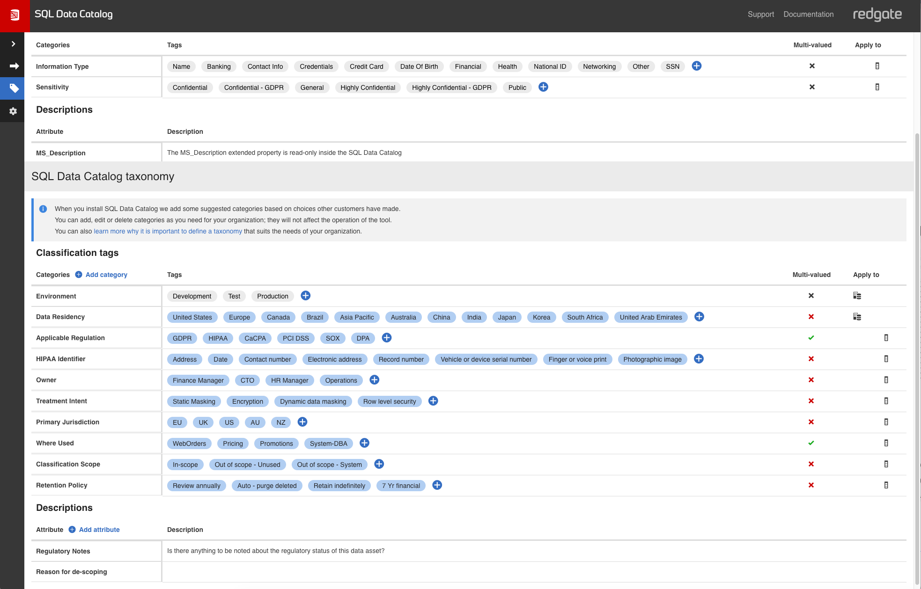
Develop a common language to describe your data
Notes:
Image: https://www.plutora.com/wp-content/uploads/2019/03/DevSecOps-Diagram.png

Slide 31
Develop a common language to describe your data
We’re planning to migrate the server, is this a high risk project?
A developer has requested access to the database, can we authorise that?
If we experience a data breach, which systems are the most critical?
Who owns this data? Who’s in charge of keeping it up to date?
Notes:
Image: https://www.plutora.com/wp-content/uploads/2019/03/DevSecOps-Diagram.png

Slide 32

Identify how data travels within the organization a.k.a. The Cotton-Eyed Joe Principle
?
Customer Data
Supplier Data
Employee Data
Purchase Data
Market Data
Reporting
Excel Files
Dumps
Backups
ETL Jobs
Notes:
Image: https://www.plutora.com/wp-content/uploads/2019/03/DevSecOps-Diagram.png

Slide 33
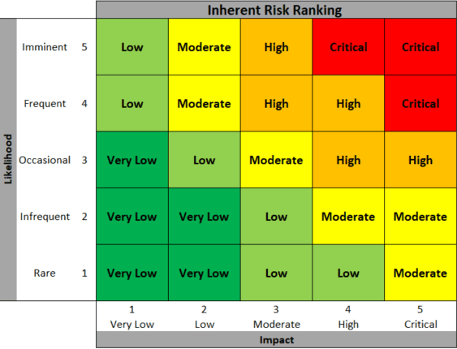
Data Protection Impact Assessments (DPIAs)
Required for processing that is likely to result in a high risk to individuals.
It must:
Describe the nature, scope, context and purposes of the processing;
Assess necessity, proportionality and compliance measures;
Identify and assess risks to individuals; and
Identify any additional measures to mitigate those risks.
Processing activities are measured in a risk matrix

Slide 34
Defensible Position Tip #4
Reduce the attack surface area of data
If there are lots of places data CAN breach, it increases the likelihood significantly
Minimize:
The number of locations production data is stored
Who has access to Prod & Prod data sets
Unencrypted files on file shares
Notes:
Image: https://images.unsplash.com/photo-1543877928-4993f5e161ef?ixlib=rb-1.2.1&ixid=eyJhcHBfaWQiOjEyMDd9&auto=format&fit=crop&w=693&q=80

Slide 35
Defensible Position Tip #5
De-Identify data in non-production environments
Mask data so that you retain business logic and useful fields but so data subjects are unidentifiable
Retain statistical and demographic variations, outliers and anomalies for analytics
If data is breached, it is useless to external actors
Notes:
Image: https://images.unsplash.com/photo-1511298521967-cefc9f26ec55?ixlib=rb-1.2.1&ixid=eyJhcHBfaWQiOjEyMDd9&auto=format&fit=crop&w=671&q=80

Slide 36
Defensible Position Tip #6
Standardize the development process
Enforce coding standards, planning and progress tracking and toolsets
It becomes easier to know where in the cycle issues can (and will) be introduced
It better enables easier accountability & auditability
Notes:
Image: https://images.unsplash.com/photo-1516546453174-5e1098a4b4af?ixlib=rb-1.2.1&ixid=eyJhcHBfaWQiOjEyMDd9&auto=format&fit=crop&w=700&q=80

Slide 37
Defensible Position Tip #7
Source Control ALL the things
Fully traceable and understandable history of all database changes
Track changes at a work item level by linking to tools like JIRA
Easier to roll back in emergencies, spend less time unpicking DB deployments at 2am
Notes:
Image: https://images.unsplash.com/photo-1519420638722-a2a5749c32be?ixlib=rb-1.2.1&ixid=eyJhcHBfaWQiOjEyMDd9&auto=format&fit=crop&w=675&q=80

Slide 38
Defensible Position Tip #8
Automate everything (where possible)
Continuous Integration allows us to immediately see the value of code changes and detect errors
Continuous Delivery verifies that we’re not breaking later stage environments and leaving them vulnerable
Shift testing waaaaaaaay left
Notes:
Image: https://images.unsplash.com/photo-1518365050014-70fe7232897f?ixlib=rb-1.2.1&ixid=eyJhcHBfaWQiOjEyMDd9&auto=format&fit=crop&w=634&q=80

Slide 39
Defensible Position Tip #9
Review Backup policies
No longer surface backups to non-relevant or unsecured environments
Upgrade or adopt stronger encryption
Review backup retention policies, stop holding on to information indefinitely
Notes:
Image: https://images.unsplash.com/photo-1570912355338-cdb934b76b12?ixlib=rb-1.2.1&ixid=eyJhcHBfaWQiOjEyMDd9&auto=format&fit=crop&w=677&q=80

Slide 40
Defensible Position Tip #10
Monitor, monitor, monitor.
Losing availability of data can be considered a breach, keep systems up!
Identify and act on unusual behaviour
Use tools to spot what impact developers have in earlier environments – monitoring is not JUST for Prod
Notes:
Image: https://images.unsplash.com/photo-1556155092-8707de31f9c4?ixlib=rb-1.2.1&ixid=eyJhcHBfaWQiOjEyMDd9&auto=format&fit=crop&w=634&q=80

Slide 41
Correction: What SHOULD compliance mean for development?
Nothing.
Developers shouldn’t even need to think about it.

Slide 42

Conclusion
Everything is part of a process, by ensuring we establish, enforce and document the right processes and procedures, with the right people and tooling in place, we can ensure data is protected by design and by default.
This frees up developers to innovate and deliver value to end users, without adding additional worries and manual steps to their way of working.
Notes:
Image: https://images.unsplash.com/photo-1522292923399-bf8ddbd6e4e2?ixlib=rb-1.2.1&auto=format&fit=crop&w=700&q=80

Slide 43
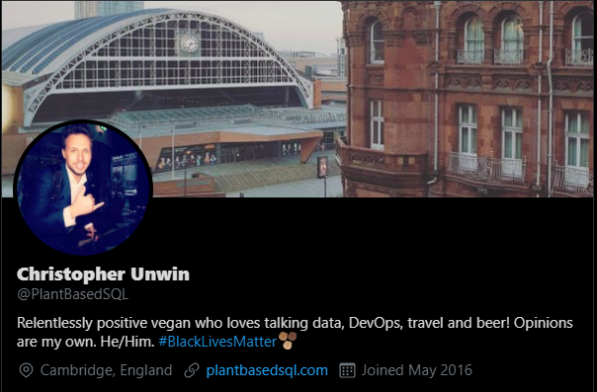
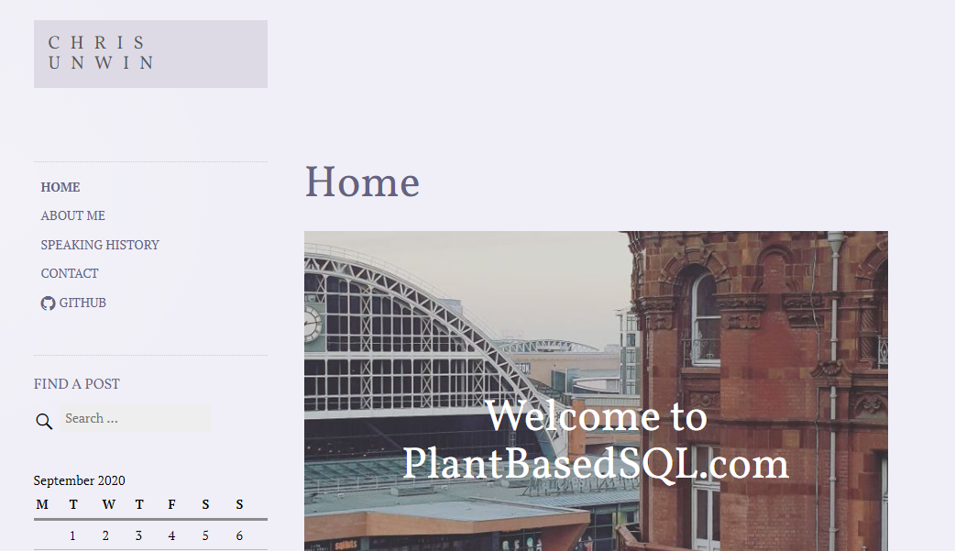
Questions & reaching out (please!)
https://twitter.com/PlantBasedSQL
https://PlantBasedSQL.com

Slide 44
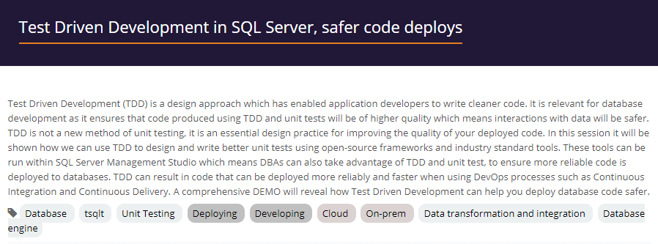

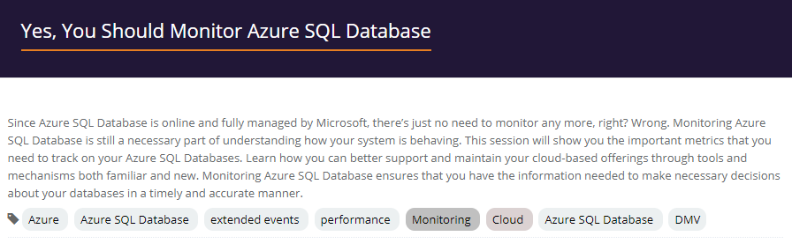

SQL Bits Sessions to check out…

Slide 45
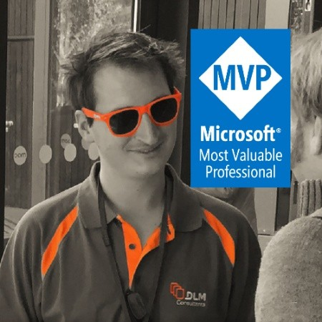

SQL Bits Sessions to check out…

Slide 46
Thank you for joining!

